Slide 1

The bootcamp projet (roleplay)
Allouch Yanis,
5th October 2020.
Mr & Mrs Bright’s son

Slide 2
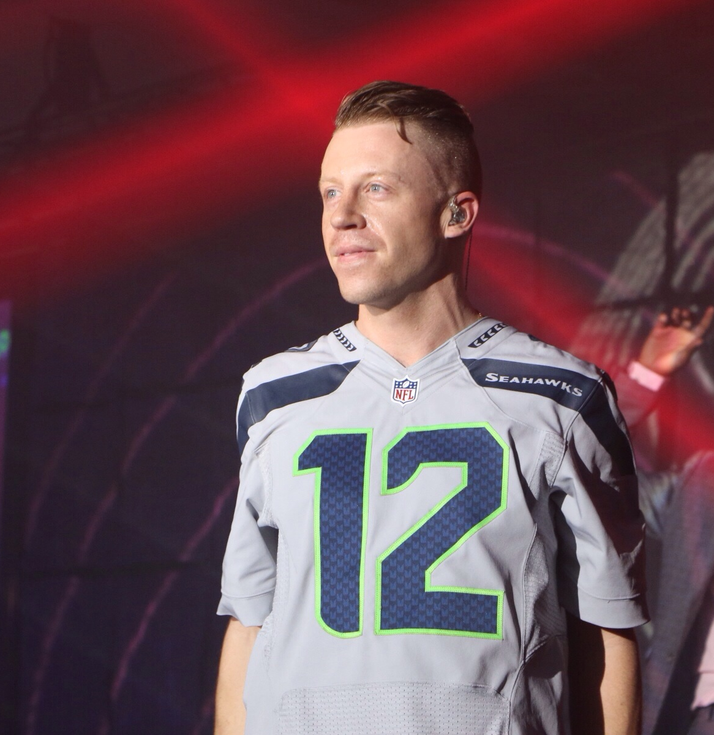
About the Struggles of Addiction and Starting Over
Benjamin Bright – 23 years old.

